Slide 1
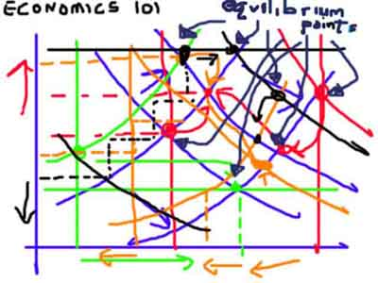
Reservation Labor Statistics Methodology
State-Tribal Relations Committee
October 21, 2015
Helena, MT
Barbara Wagner
Chief Economist

Slide 2
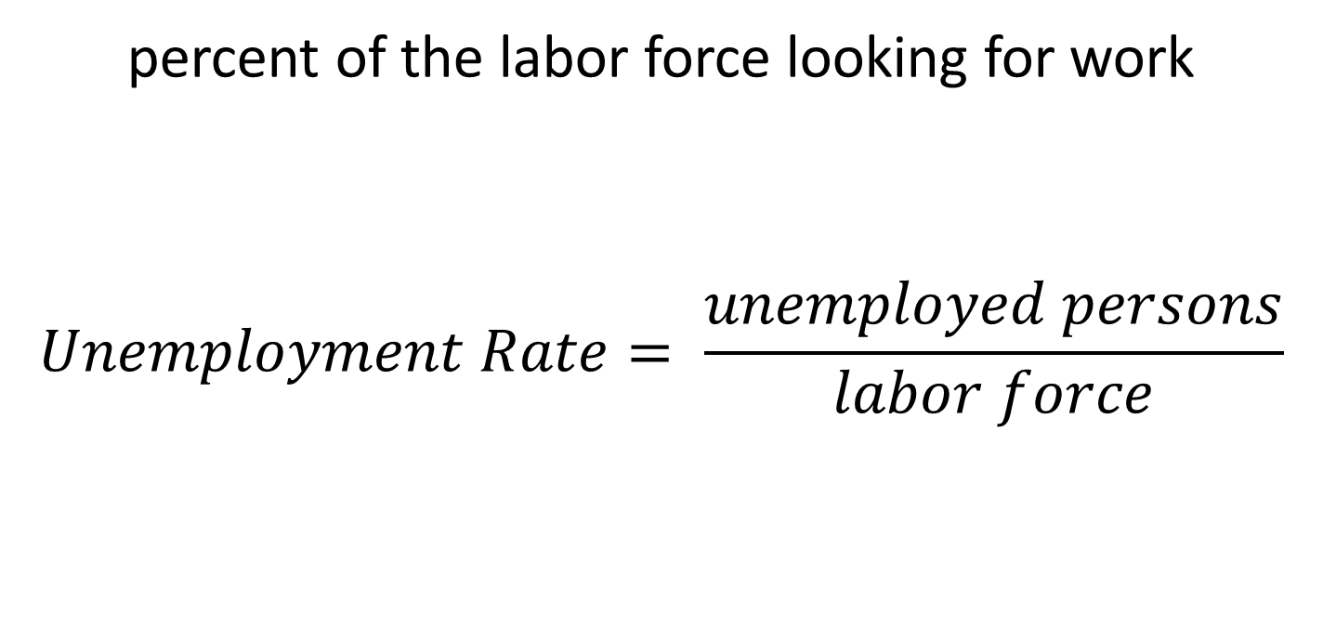
Unemployment Rate
percent of the labor force looking for work
$$Unemployment Rate= \frac{unemployed persons}{labor force}$$

Slide 3
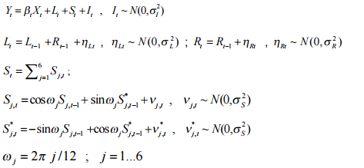
Simplified Formula
Unemployment Rate = f(Last Month Unemployment Rate, State Trend, National and Regional Trends, Household Survey, Unemployment Claims, Employer Survey, Seasonal Error, Measurement Error, Survey Error)
Additional Reading: LAUS Estimation Methodology, http://www.bls.gov/lau/laumthd.htm and
Pfeffermann and Tiller, 2002, http://eprints.soton.ac.uk/198/1/198-01.pdf

Slide 4
What does the Unemployment Rate Measure?
The unemployment rate measures how hard it is to find a job if you are looking for a job.
Measures changes in the economy
Relative measure
Rarely will exceed 20%
  At higher rates, people will stop looking for a job
  Higher rates usually indicate wars, dramatic shocks

Slide 5
Official Definitions
Unemployed
  Not Currently Working
  Were available for Work
  Made Efforts to Find Work (or were waiting to be recalled)
  Did at least 1 hour of work for pay or in their own business, or 15 hours unpaid in family enterprise
  With job, but out sick/ injured/ labor dispute/ childcare problems
Employed
Labor Force
  Either unemployed or employed

Slide 6
Employment Status of the Montana Population
In school
Other
Caring for family
Disabled
Retired
Under 16
Unemployed
Source: Current Population Survey Microdata 2017-2023, IPUMS

Slide 7
What about the rest of people?
U1 – Unemployed 15 weeks or longer
U2 – Job losers, including temporary workers
U3 – Official Rate, total unemployed
U4 – Unemployed plus discouraged workers
U5 – Unemployed, discouraged, and marginally attached
U6 – Unemployed, discouraged, marginally attached and part-time for economic reasons

Slide 8
Alternative Measures of Unemployment For Montana
Source: LAUS, Alternative Measures of Labor Underutilization for State, BLS

Slide 9
Other Employment Metrics:
Labor Force Participation Rates
Percent of the population over 16 in the labor force
Used as a measure of economic engagement
Affected by economic performance, age demographics, wages, and more
Source: Current Population Survey 2017-2023

Slide 10
Labor Force Participation in Montana
Affected by both Recession and Demographics
Montana and U.S. Labor Force Participation Rates Since 1976
MT
62.6%
US
62.6%
Source: Local Area Unemployment Statistics for Montana and Current Population Survey for U.S., Bureau of Labor Statistics and MT Dept of Labor and Industry (MT DLI)

Slide 11
Other Employment Metrics
Employment to Population Ratios
Percent of population who are employed (needs Census data)
Affected by demographics
  Sometimes adjusted for demographics using just people 16 to 64 years of age
Combination of labor force participation and unemployment rates
Better measure for persistently poor economic conditions, but not a measure of economic changes

Slide 12
Employment to Population Ratio
Employment Status of Montanans over 16, 2017-2023
Blue represents not in Labor Force
Source: Current Population Survey microdata compiled by MT DLI using monthly data from Jan 2017 to Dec 2023

Slide 13
Why is it so hard to measure reservation economies?
Small populations require costly and large samples
Rural areas have the highest data collection costs due to population density
Flaws in one data source affect other data
Sovereignty requires cooperation between governments
Cost
Accuracy

Slide 14
Step 1: National Unemployment Rate
Larger populations require lower relative sample sizes
  Reduces cost of producing labor statistics
Estimated from the Current Population Survey
  Telephone Survey about 60,000 households (110,000 people)
    740 households in Montana
  Cluster-based design using Census population data

Slide 15
Step 2: Divvy Employment out to States Based on State-Level Data
Montana is too small of a population / sample to produce estimates with telephone survey. Supplemental data needed.
  Current Population Data (national survey)
  Current Employment Estimates
    Survey of 3,600 Montana employers each month
      Most reported automatically by national employers
  Unemployment Insurance Claims
    Only about 30% to 40% of unemployed people receive claims
    Most important for tracking sudden changes, like layoffs

Slide 16
Data Sources Used in Creating the State Unemployment Rate
Current Population Survey (Household Survey)
Current Employment Statistics
(Employer Survey)
Quarterly Census of Employment and Wages
Census Population Counts
Unemployment Insurance Claims
National Unemployment Rate

Slide 17
Step 3: Divvy Employment / Unemployed out to Local Areas
County cannot have more jobs than people
  Know the number of people based on Census Population Data
Employment initially allocated to counties based on annual employment counts from Quarterly Census of Employment and Wages (and other data).
  Mandatory reporting of employment for UI purposes
  Census of all payroll employment, not survey estimate
Change in initial level based on claims and employer survey

Slide 18
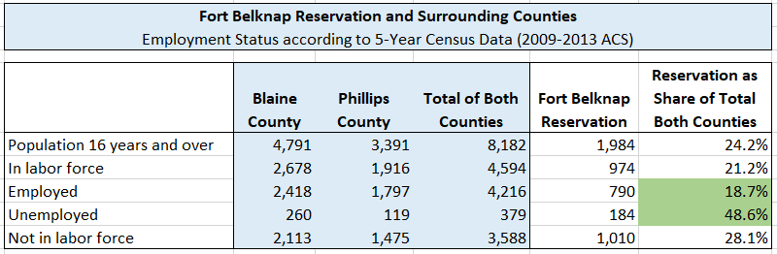
Step 4: Allocate County Employment/ Unemployment to Reservations
Use ratios from American Community Survey data to allocate employed / unemployed
Uses population shares from 2009-2013 ACS. BLS plans to update population shares in 2025

Slide 19
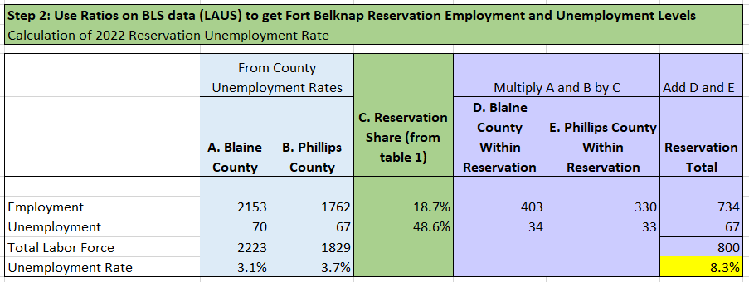
Step 4: Continued…
Use ratios from American Community Survey data to allocate BLS employed / unemployed

Slide 20
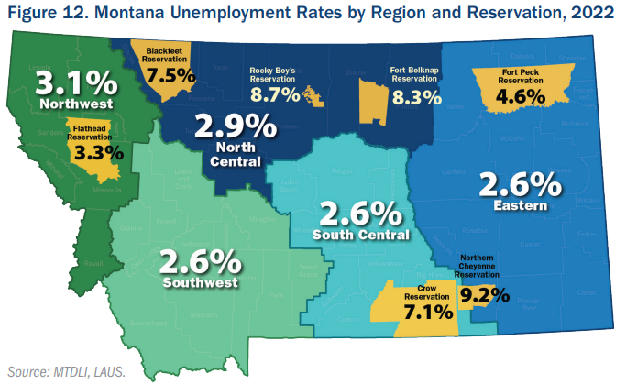
2022 Unemployment Rates for
Regions and Reservations

Slide 21
Step 5: End of Year Benchmarking
Use known employment totals from Quarterly Census of Employment and Wages to re-estimate monthly data
  Reduce variance and better allocation to local areas
Update population controls
Re-estimate data
  Reduces variance and improves trend accuracy

Slide 22
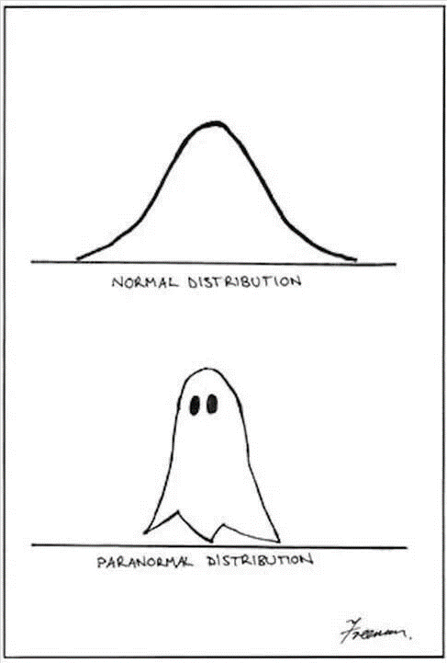
Criticisms
This method is obviously not perfect for Montana’s small populations.
Data collection challenges in rural areas, especially reservations
Tribal sovereignty removes some data
No data collected on tribe or race

Slide 23
Criticisms:
Step 1: National Unemployment Rate
Estimated from the Current Population Survey
  Telephone Survey about 60,000 households (110,000 people)
    740 households in Montana
  Cluster-based design using Census population data
Larger populations require lower relative sample sizes
  Reduces cost of producing labor statistics
Concerns about the use of telephones on reservations
Over-sample reservation areas, but still small population

Slide 24
Criticisms: Step 2: Divvy Employment out to States Based on State-Level Data
Montana is too small of a population / sample to produce estimates only on telephone survey. Supplemental data needed.
  Current Employment Estimates
    Survey of 3,600 Montana employers each month
      Most reported automatically by national employers
  Unemployment Insurance Claims
    Only about 30% to 40% of unemployed people receive claims
    Most important for tracking sudden changes, like layoffs
Includes tribal businesses
Some reservations have their own UI programs
(data sharing)

Slide 25
Criticisms on Step 3: Divvy Employment / Unemployed out to Local Areas
County cannot have more jobs than people
  Know the number of people based on Census Population Data
Employment initially allocated to counties based on annual employment counts from Quarterly Census of Employment and Wages (and other data).
  Mandatory reporting of employment for UI purposes
  Census of all payroll employment, not Census
Change in initial level based on claims and employer survey
Tax Records Used in Many Federal Data Programs
Won’t mail to PO Boxes in Rural Areas
Reporting often incomplete or delayed

Slide 26
Criticisms on Step 4: Allocate County Employment/ Unemployment to Reservations
Use ratios from American Community Survey data to allocate employed / unemployed
This method actually makes sense and seems to do a good job of representing economies.

Slide 27
Benefits of Monthly Unemployment
Rate Metrics using BLS Methodology
  Ability to compare to other areas
  Consistent measurement across time
  Ability to measure effectiveness of interventions
  More timely than every five years

Slide 28
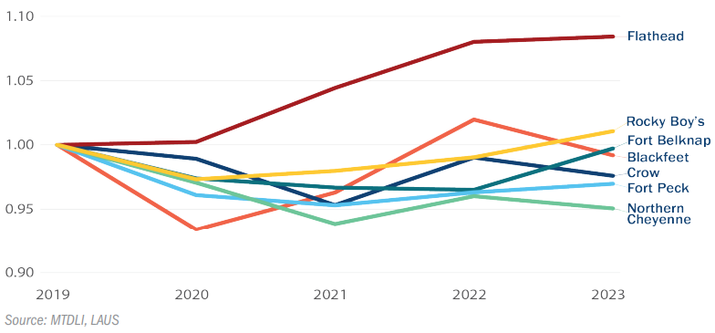
Over-the-year Change in Employment on Montana’s Reservations
Source: Local Area Unemployment Statistics, Montana Dept of Labor and Industry

Slide 29
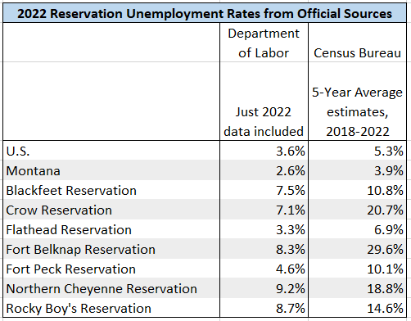
Possible Alternatives and Improvements
Census Bureau Unemployment Rates

Slide 30
Possible Alternatives and Improvements
2. Bureau of Indian Affairs Labor Market Survey
  Did own data collection, but last published in 2005
  Now using Census Data
2005 Data had significant differences to BLS data
  Included American Indians only
  Did not remove retired, homemakers, or students. Some disabled removed.
    More like an employment to population ratio than an unemployment rate
  Work needed to be for money, not compensation

Slide 31
Possible Alternatives and Improvements:
Bureau of Indian Affairs, Cont.
2013 Report using Census data has lots of great information, but not unemployment rates. In their own words (pg 9):
“It is very important to note that this report does not provide any estimates of “unemployment.” “Unemployment,” refers to the proportion of people in “the labor force” who are not working….This measurement standard has long been established in the Federal Statistical System.
The above-mentioned standard definition of unemployment does not reflect any judgment as to whether people who are not working, and who want a job, should be actively looking for work. Indeed, it may well be the case that there are no job opportunities in certain areas of Indian Country, thereby making it pointless, or perhaps even irrational, for anyone without a job under these circumstances to be continually and actively looking for one in the same, economically depressed, geographic area.
Therefore, none of the statistics provided in this report should be seen as reflecting or representing estimates of unemployment. Anyone who uses the statistics provided in this report to infer any statement about unemployment with regard to any individual tribe, with regard to the tribes in a state or region, or with regard to Indian Country overall, will be misinterpreting and misrepresenting the findings of this report.“
U.S. Department of Interior, Indian Affairs Report can be found at www.bia.gov/cs/groups/public/documents/text/idc1-024782.pdf

Slide 32
More Information Available: www.lmi.mt.gov

